Slide 1
State Estimation Exercise Completed By: Darius Mensah 11/13/2023

Slide 2
Overview
Integration Architecture
Assumptions
Navigation Equations Utilized
Methods
Results
Analysis
Conclusions
Limitations/improvements
Backup charts
References

Slide 3
Integration Architecture
The integrated navigation solution is comprised of two components:
The inertial navigation solution
Global navigation satellite system
Based on the format of the GPS measurements a ‘loosely coupled’ INS/GNSS sensor fusion algorithm was developed.
‘Loosely coupled’ refers to using GNSS position and velocity measurements as inputs into the fusion algorithm

Slide 4
Loosely Coupled Integration
Total State INS/GNSS integration architecture:
GNSS user equipment
IMU
Measurement Update
System Propagation
Integrated Navigation Solution
Sensor Fusion Algorithm

Slide 5
Assumptions
Some of the general assumptions involved in the exercise include:
The effects of the earth’s gravitational field on the tractor could be assumed to be constant due to the lack of variation in latitude and longitude.
Like the previous point, the rotation of the earth will cause very minor effects on the gyroscope readings due to the lack of latitude and longitude variation.
Both the GPS and IMU are collocated and mounted to the vehicle body center of gravity.
Sensors are not ideal and potentially contain noise and biases.

Slide 6

Inertial Navigation
Initial Conditions
IMU
3 axis accelerometer
$$\left[\begin{matrix}position \\ velocity \\ orientation\end{matrix}\right]$$
Navigation Processor
3 axis gyroscope
Gravitational Field Model

Slide 7
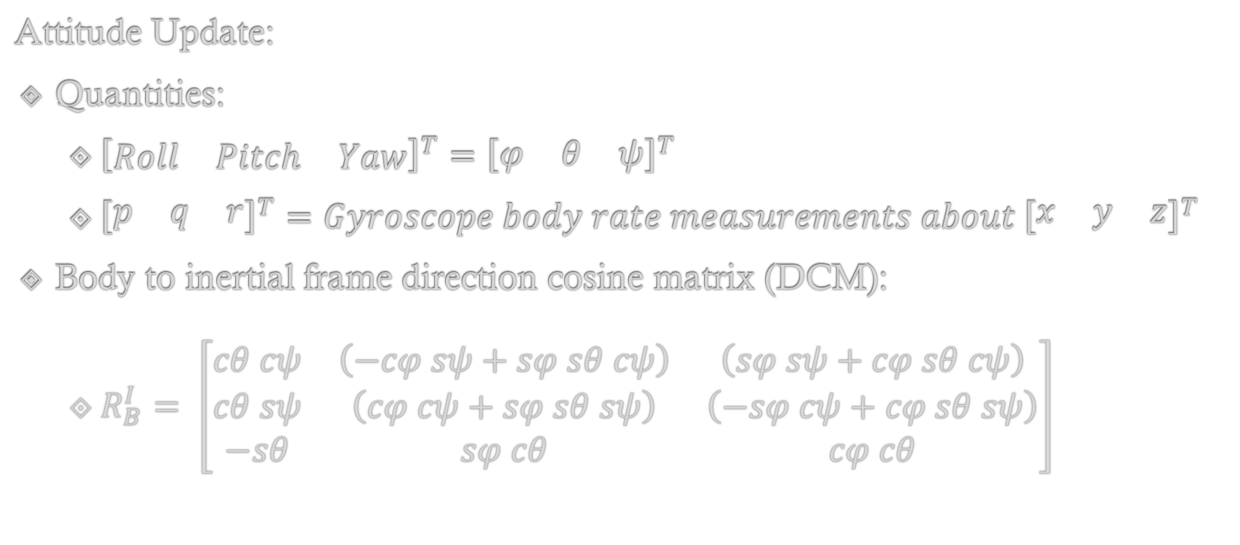
Navigation Equations
Attitude Update:
Quantities:
${\left[\begin{matrix}Roll & Pitch & Yaw\end{matrix}\right]}^{T}={\left[\begin{matrix}φ & θ & ψ\end{matrix}\right]}^{T}$
${\left[\begin{matrix}p & q & r\end{matrix}\right]}^{T}=Gyroscope body rate measurements about {\left[\begin{matrix}x & y & z\end{matrix}\right]}^{T}$
Body to inertial frame direction cosine matrix (DCM):
$R_{B}^{I}= \left[\begin{matrix}cθ cψ & \left(−cφ sψ+sφ sθ cψ\right) & \left(sφ sψ+cφ sθ cψ\right) \\ cθ sψ & \left(cφ cψ+sφ sθ sψ\right) & \left(−sφ cψ+cφ sθ sψ\right) \\ −sθ & sφ cθ & cφ cθ\end{matrix}\right]$

Slide 8
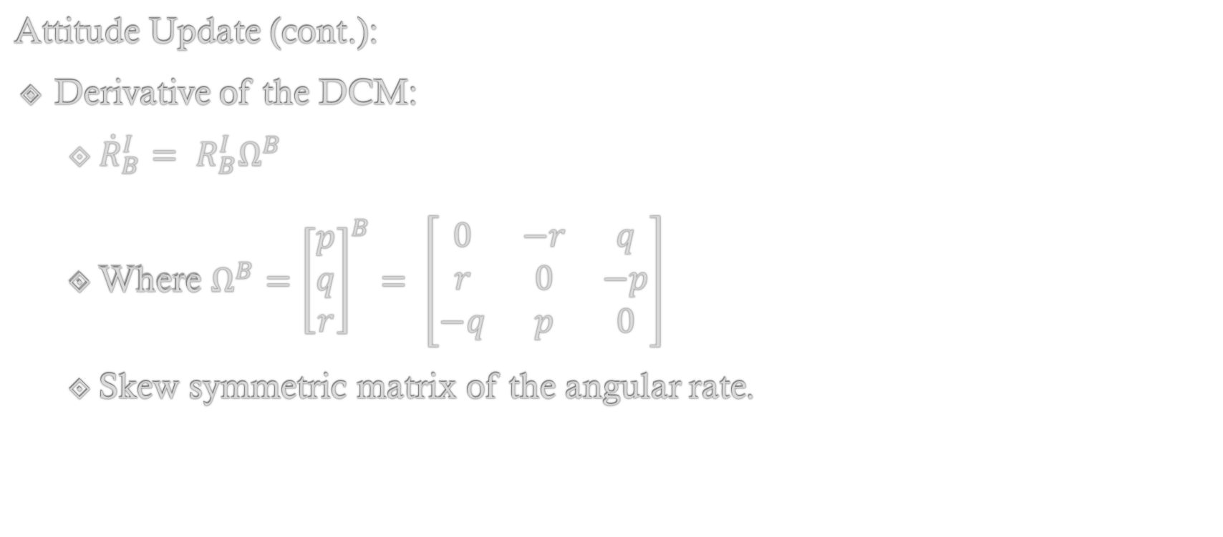
Navigation Equations
Attitude Update (cont.):
Derivative of the DCM:
${\dot{R}}_{B}^{I}= R_{B}^{I}Ω^{B}$
Where ${Ω^{B}=\left[\begin{matrix}p \\ q \\ r\end{matrix}\right]}^{B}= \left[\begin{matrix}0 & −r & q \\ r & 0 & −p \\ −q & p & 0\end{matrix}\right]$
Skew symmetric matrix of the angular rate.

Slide 9
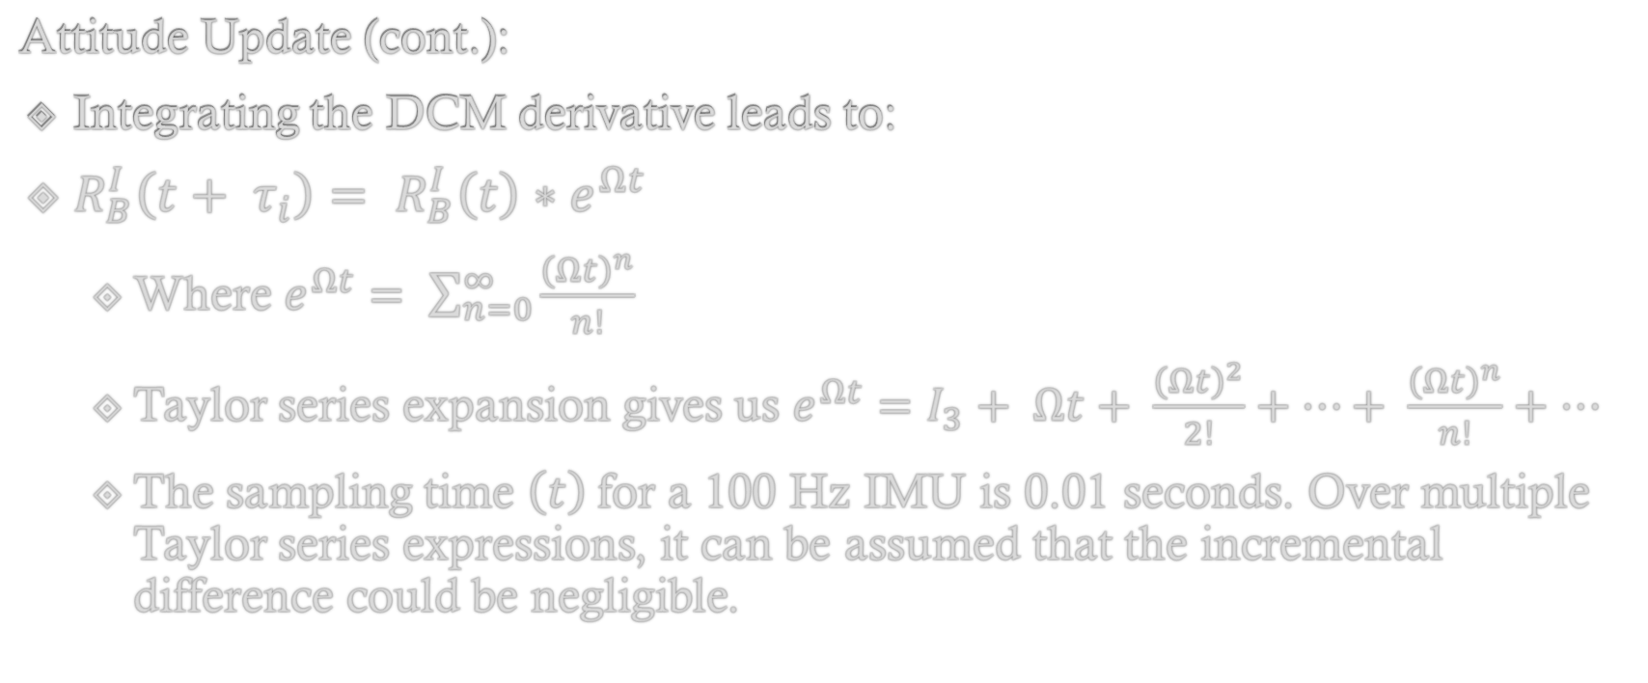
Navigation Equations
Attitude Update (cont.):
Integrating the DCM derivative leads to:
$R_{B}^{I}\left(t+ τ_{i}\right)= R_{B}^{I}\left(t\right)∗e^{Ωt}$
Where $e^{Ωt}= \sum_{n=0}^{∞}{\frac{{\left(Ωt\right)}^{n}}{n!}}$
Taylor series expansion gives us $e^{Ωt}=I_{3}+ Ωt+ \frac{{\left(Ωt\right)}^{2}}{2!}+…+ \frac{{\left(Ωt\right)}^{n}}{n!}+…$
The sampling time $\left(t\right)$for a 100 Hz IMU is 0.01 seconds. Over multiple Taylor series expressions, it can be assumed that the incremental difference could be negligible.

Slide 10
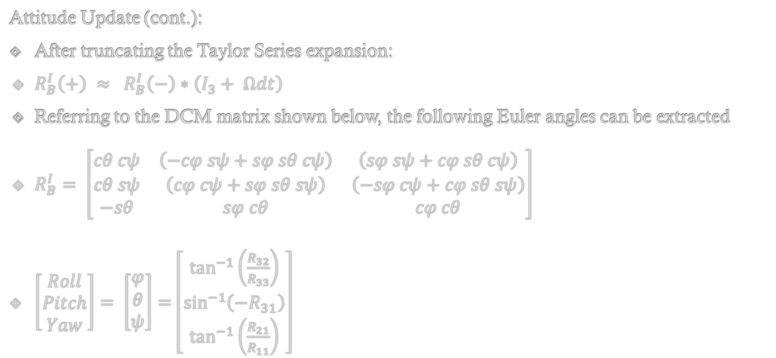
Navigation Equations
Attitude Update (cont.):
After truncating the Taylor Series expansion:
$R_{B}^{I}\left(+\right) ≈ R_{B}^{I}\left(−\right)∗\left(I_{3}+ Ωdt\right)$
Referring to the DCM matrix shown below, the following Euler angles can be extracted
$R_{B}^{I}= \left[\begin{matrix}cθ cψ & \left(−cφ sψ+sφ sθ cψ\right) & \left(sφ sψ+cφ sθ cψ\right) \\ cθ sψ & \left(cφ cψ+sφ sθ sψ\right) & \left(−sφ cψ+cφ sθ sψ\right) \\ −sθ & sφ cθ & cφ cθ\end{matrix}\right]$
$\left[\begin{matrix}Roll \\ Pitch \\ Yaw\end{matrix}\right]= \left[\begin{matrix}φ \\ θ \\ ψ\end{matrix}\right]=\left[\begin{matrix}\tan^{−1}\left(\frac{R_{32}}{R_{33}}\right) \\ \sin^{−1}\left({−R}_{31}\right) \\ \tan^{−1}\left(\frac{R_{21}}{R_{11}}\right)\end{matrix}\right]$

Slide 11
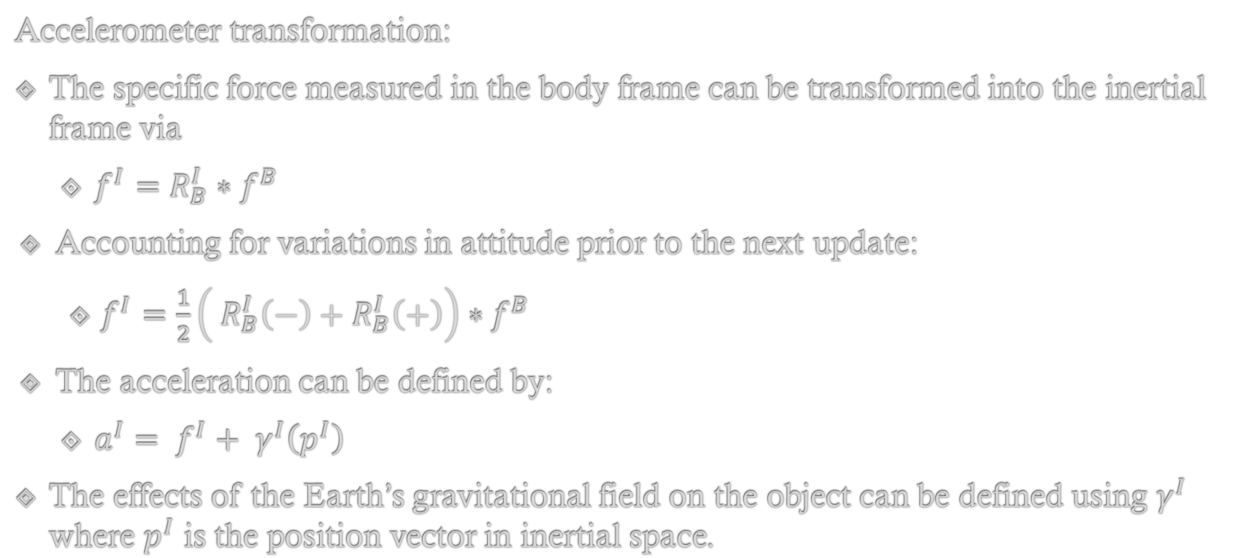
Navigation Equations
Accelerometer transformation:
The specific force measured in the body frame can be transformed into the inertial frame via
$f^{I}=R_{B}^{I}∗{ f}^{B}$
Accounting for variations in attitude prior to the next update:
$f^{I}=\frac{1}{2}\left({ R}_{B}^{I}\left(−\right)+R_{B}^{I}\left(+\right)\right){ ∗f}^{B}$
The acceleration can be defined by:
$a^{I}= f^{I}+ γ^{I}\left(p^{I}\right)$
The effects of the Earth’s gravitational field on the object can be defined using $γ^{I}$ where $p^{I}$ is the position vector in inertial space.

Slide 12
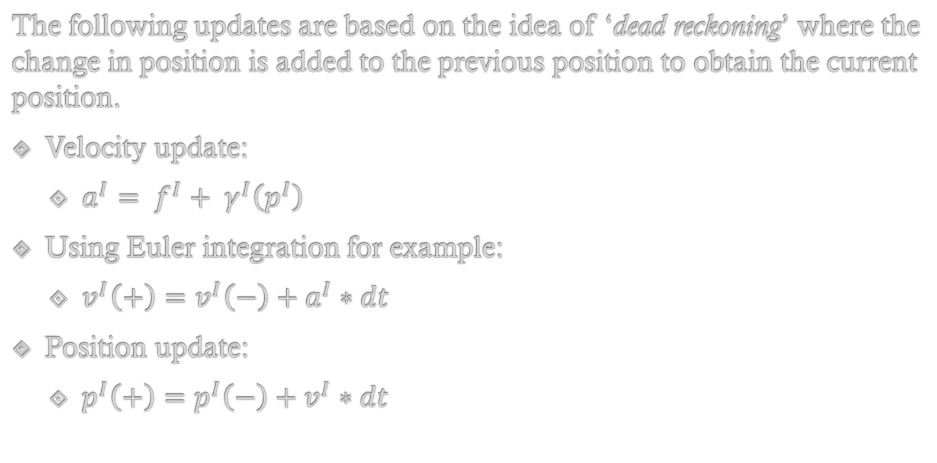
Navigation Equations
The following updates are based on the idea of ‘dead reckoning’ where the change in position is added to the previous position to obtain the current position.
Velocity update:
$a^{I}= f^{I}+ γ^{I}\left(p^{I}\right)$
Using Euler integration for example:
$v^{I}\left(+\right)=v^{I}\left(−\right)+a^{I}∗dt$
Position update:
$p^{I}\left(+\right)=p^{I}\left(−\right)+v^{I}∗dt$

Slide 13
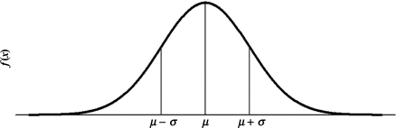
Methods of implementation
The Unscented Kalman Filter (UKF) was utilized. The upside to this algorithm is that it does not require a Jacobian matrix of partial derivatives like the Extended Kalman filter for non-linear models.
Generating sigma vectors (or sigma points) to find other ‘potential’ state vectors and then outputting the optimal prediction via the unscented transform.
The image below essentially shows a single state example where there are 3 sigma points
Typically, 2n+1 sigma points are determined where n is the number of states.

Slide 14
Methods of implementation
A 15 state UKF was developed versus an error state algorithm to estimate the following (each has 3 components):
Attitude
Velocity (inertial frame)
Position (inertial frame)
IMU biases:
Accelerometer bias
Gyroscope Bias

Slide 15
Methods of implementation
The idea of ‘pseudo measurements’ were applied to the algorithm where (for example) measured quantities could be transformed (using equations) into useful values.
Pseudo measurements:
The IMU had a roughly 100 Hz sampling rate while the GPS has a 10 Hz rate
Due to this, the navigation equations were run at 100 Hz and the GPS corrections only occurred once every 10 IMU measurements.
However; in between GPS updates, the previous states were extrapolated as ‘pseudo measurements’

Slide 16
Methods of implementation
In this algorithm ‘pseudo measurements’ were applied in the following ways:
Extrapolation where there is latent data
For example, sensors having different sampling rates
Converting accelerometer measurements into roll and pitch angles
Transforming the velocity measured by the GPS into a heading angle

Slide 17
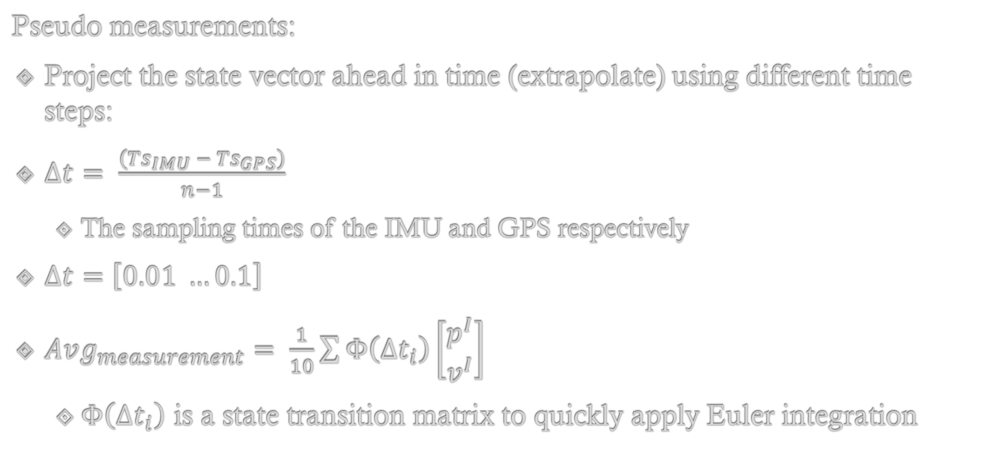
Methods of implementation
Pseudo measurements:
Project the state vector ahead in time (extrapolate) using different time steps:
$Δt= \frac{\left({Ts}_{IMU} − {Ts}_{GPS}\right)}{n−1}$
The sampling times of the IMU and GPS respectively
$Δt=$ $\left[0.01 …0.1\right]$
$Avg_{measurement}= \frac{1}{10}\sum{Φ\left({Δt}_{i}\right)\left[\begin{matrix}p^{I} \\ v^{I}\end{matrix}\right]}$
$Φ\left({Δt}_{i}\right)$ is a state transition matrix to quickly apply Euler integration

Slide 18
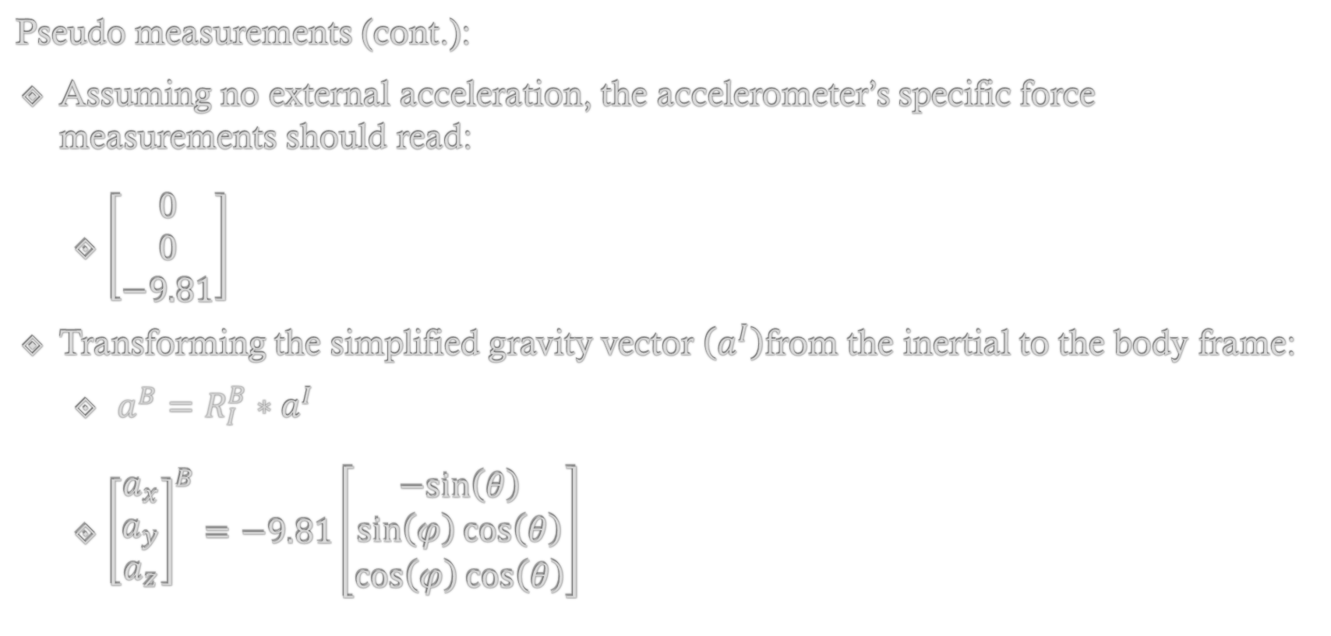
Methods of implementation
Pseudo measurements (cont.):
Assuming no external acceleration, the accelerometer’s specific force measurements should read:
$\left[\begin{matrix}0 \\ 0 \\ −9.81\end{matrix}\right]$
Transforming the simplified gravity vector $\left(a^{I}\right)$from the inertial to the body frame:
${a^{B}=R}_{I}^{B}∗a^{I}$
${\left[\begin{matrix}a_{x} \\ a_{y} \\ a_{z}\end{matrix}\right]}^{B}=−9.81\left[\begin{matrix}−sin\left(θ\right) \\ \sin\left(φ\right)cos\left(θ\right) \\ \cos\left(φ\right)\cos\left(θ\right)\end{matrix}\right]$

Slide 19
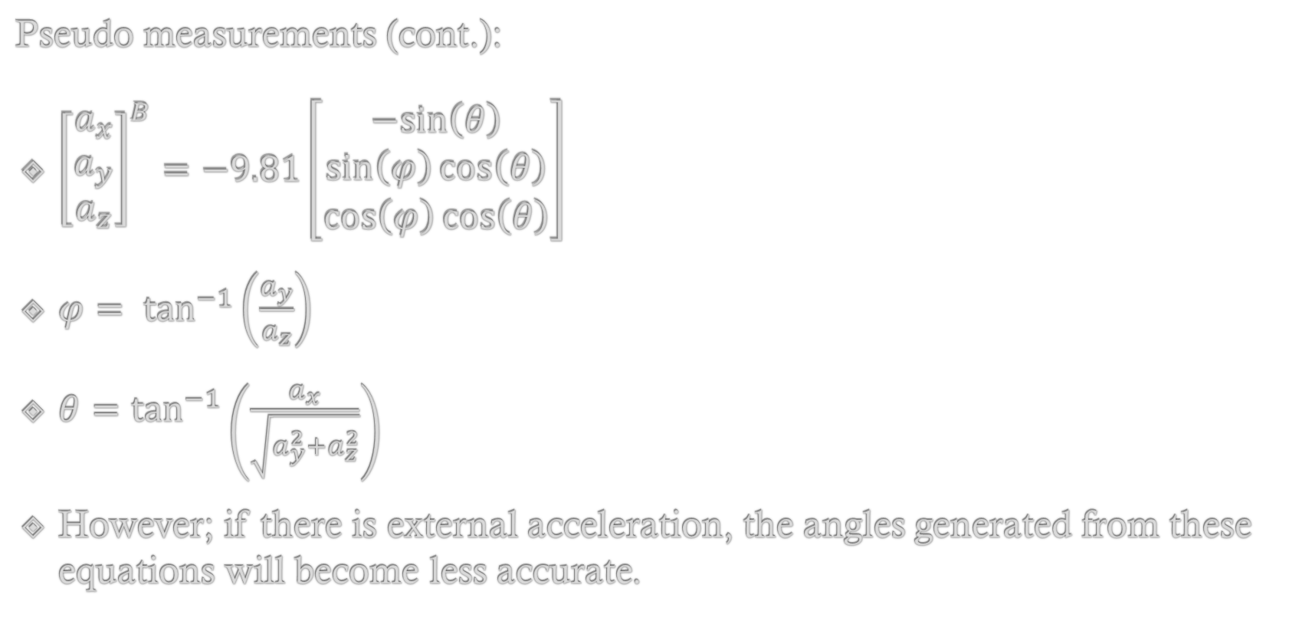
Methods of implementation
Pseudo measurements (cont.):
${\left[\begin{matrix}a_{x} \\ a_{y} \\ a_{z}\end{matrix}\right]}^{B}=−9.81\left[\begin{matrix}−sin\left(θ\right) \\ \sin\left(φ\right)cos\left(θ\right) \\ \cos\left(φ\right)\cos\left(θ\right)\end{matrix}\right]$
$φ= \tan^{−1}\left(\frac{a_{y}}{a_{z}}\right)$
$θ=\tan^{−1}\left(\frac{a_{x}}{\sqrt{a_{y}^{2}+a_{z}^{2}}}\right)$
However; if there is external acceleration, the angles generated from these equations will become less accurate.

Slide 20


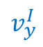
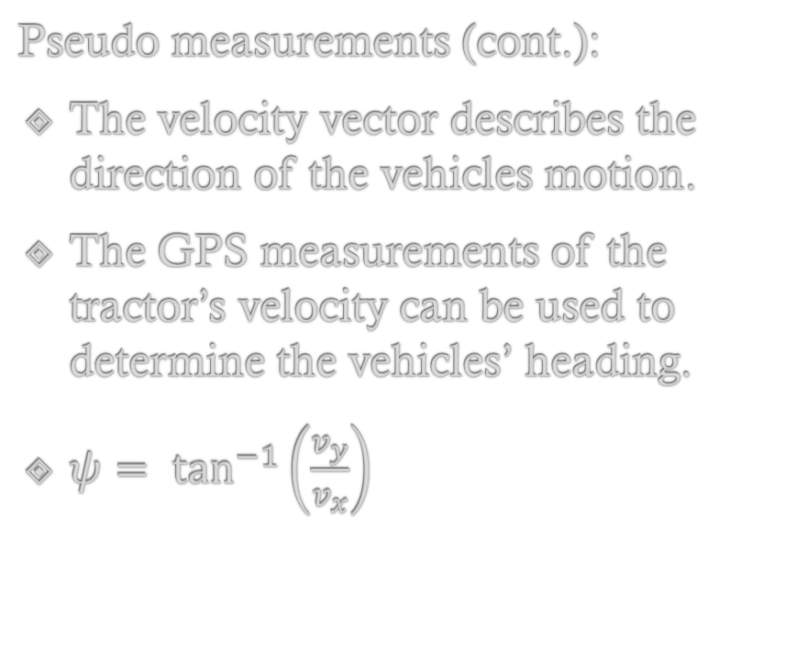
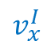


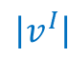
Methods of implementation
Pseudo measurements (cont.):
The velocity vector describes the direction of the vehicles motion.
The GPS measurements of the tractor’s velocity can be used to determine the vehicles’ heading.
$ψ= \tan^{−1}\left(\frac{v_{y}}{v_{x}}\right)$
$$y^{I}$$
$$v_{y}^{I}$$
$$\left|v^{I}\right|$$
$$ψ$$
$$v_{x}^{I}$$
$$z^{I}$$
$$x^{I}$$

Slide 21
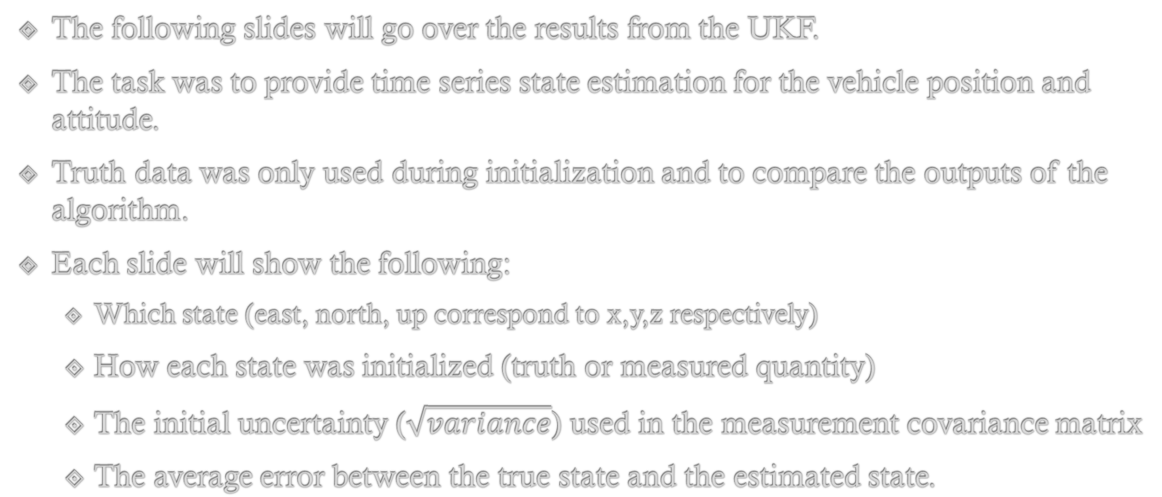
Results
The following slides will go over the results from the UKF.
The task was to provide time series state estimation for the vehicle position and attitude.
Truth data was only used during initialization and to compare the outputs of the algorithm.
Each slide will show the following:
Which state (east, north, up correspond to x,y,z respectively)
How each state was initialized (truth or measured quantity)
The initial uncertainty ($\sqrt{variance}$) used in the measurement covariance matrix
The average error between the true state and the estimated state.

Slide 22
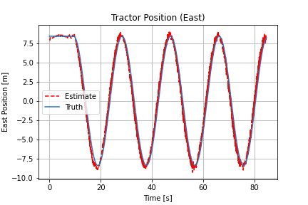
Results
Tractor position (east):
Initialized using the first GPS measurement.
Measurement uncertainty = 0.25 m
Average east position error
(Truth - Estimate) = 4.373 cm

Slide 23
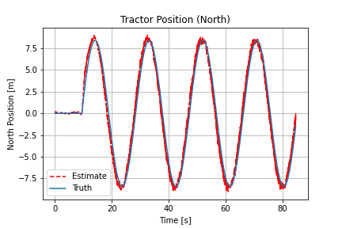
Results
Tractor position (north):
Initialized using the first GPS measurement.
Measurement uncertainty = 0.25 m
Average north position error
(Truth - Estimate) = -0.0753 cm

Slide 24
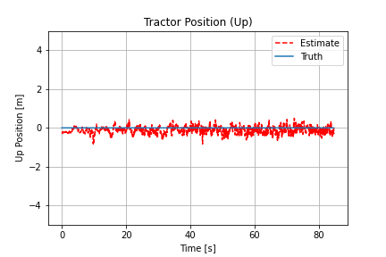
Results
Tractor position (upward):
Initialized using the first GPS measurement.
Measurement uncertainty = 0.25 m
Average upward position error:
(Truth - Estimate) = 11.662 cm

Slide 25
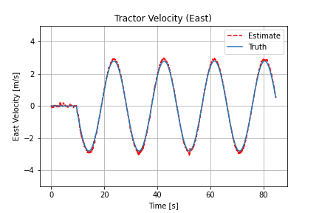
Results
Tractor velocity (east):
Initialized using the first GPS measurement
Measurement uncertainty = 0.1 m/s
Average east velocity error:
(Truth - Estimate) = -0.00268 m/s
Notes:
Negative residual = an overestimate

Slide 26
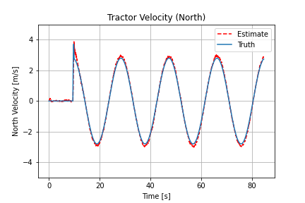
Results
Tractor velocity (north):
Initialized using the first GPS measurement
Measurement uncertainty = 0.1 m/s
Average north velocity error
(Truth - Estimate) = - 0.0105 m/s

Slide 27
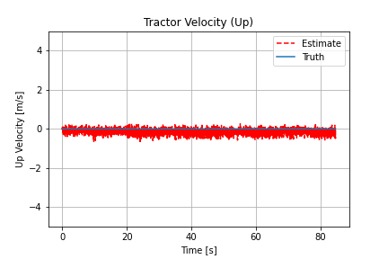
Results
Tractor velocity (upward):
Initialized using the first GPS measurement
Measurement uncertainty = 0.1 m/s
Average upward velocity error =
(Truth - Estimate) = 0.157 m/s

Slide 28
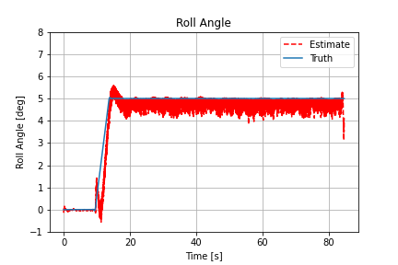
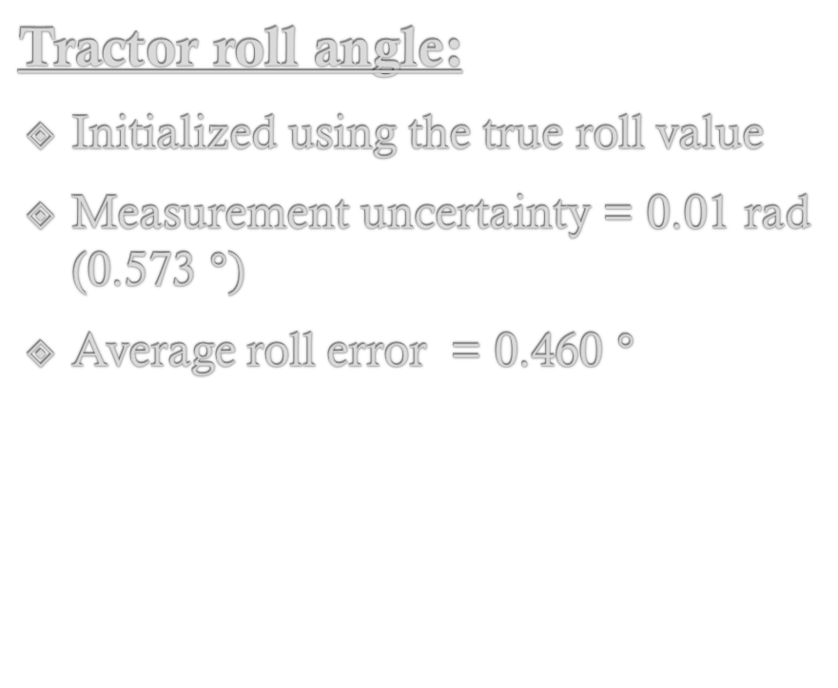
Results
Tractor roll angle:
Initialized using the true roll value
Measurement uncertainty = 0.01 rad (0.573 $°)$
Average roll error = 0.460 $°$

Slide 29
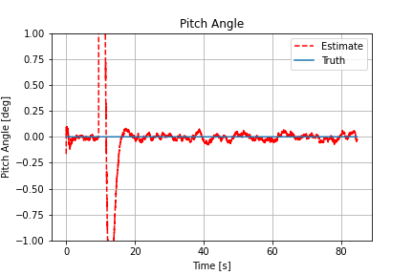
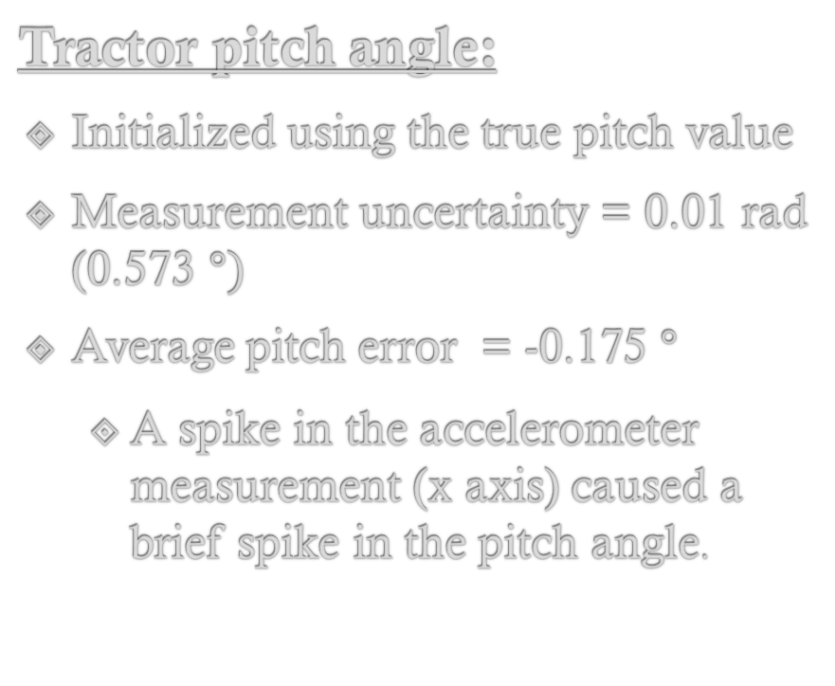
Results
Tractor pitch angle:
Initialized using the true pitch value
Measurement uncertainty = 0.01 rad (0.573 $°)$
Average pitch error = -0.175 $°$
A spike in the accelerometer measurement (x axis) caused a brief spike in the pitch angle.

Slide 30
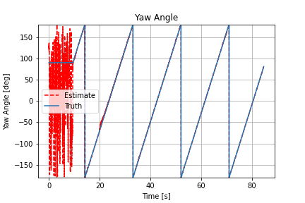
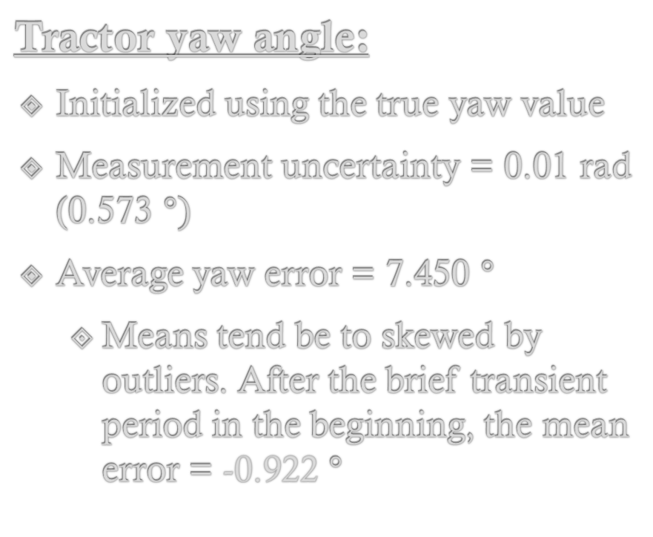
Results
Tractor yaw angle:
Initialized using the true yaw value
Measurement uncertainty = 0.01 rad (0.573 $°)$
Average yaw error = 7.450 $°$
Means tend be to skewed by outliers. After the brief transient period in the beginning, the mean error = -0.922 $°$

Slide 31
Analysis
There where issues with some of the state estimates (particularly attitude)
The following slides will go into some of the reasons behind those issues
In addition, there were steps in the algorithm not fully explained, so they will get explored in this section.

Slide 32







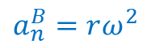
Analysis
Attitude considerations:
Due to the tractor moving in a circle, the accelerometers will measure angular acceleration.
The centripetal (normal) component of the acceleration will contribute greatly to the accelerometer measurements.
This must be accounted for in the algorithm to maintain accurate angle estimates.
$$y^{I}$$
$$y^{B}$$
$$z^{I}$$
$$x^{I}$$
$$a_{t}^{B}=r\dot{ω}$$
$$z^{B}$$
$$x^{B}$$
$$a_{n}^{B}=rω^{2}$$

Slide 33
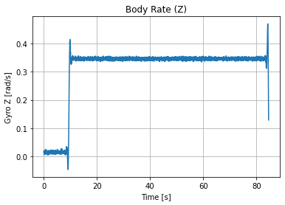
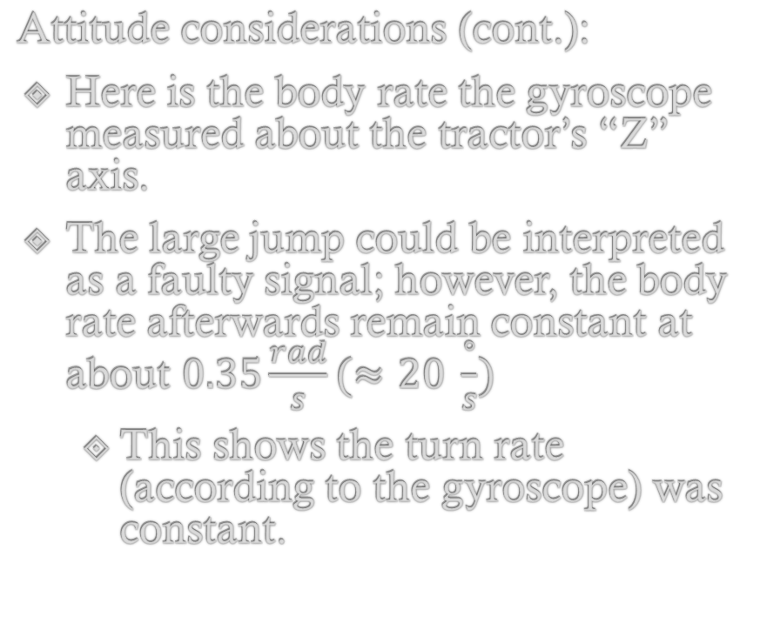
Analysis
Attitude considerations (cont.):
Here is the body rate the gyroscope measured about the tractor’s “Z” axis.
The large jump could be interpreted as a faulty signal; however, the body rate afterwards remain constant at about $0.35\frac{rad}{s}(≈20 \frac{°}{s})$
This shows the turn rate (according to the gyroscope) was constant.

Slide 34
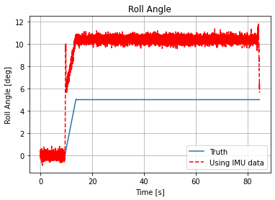
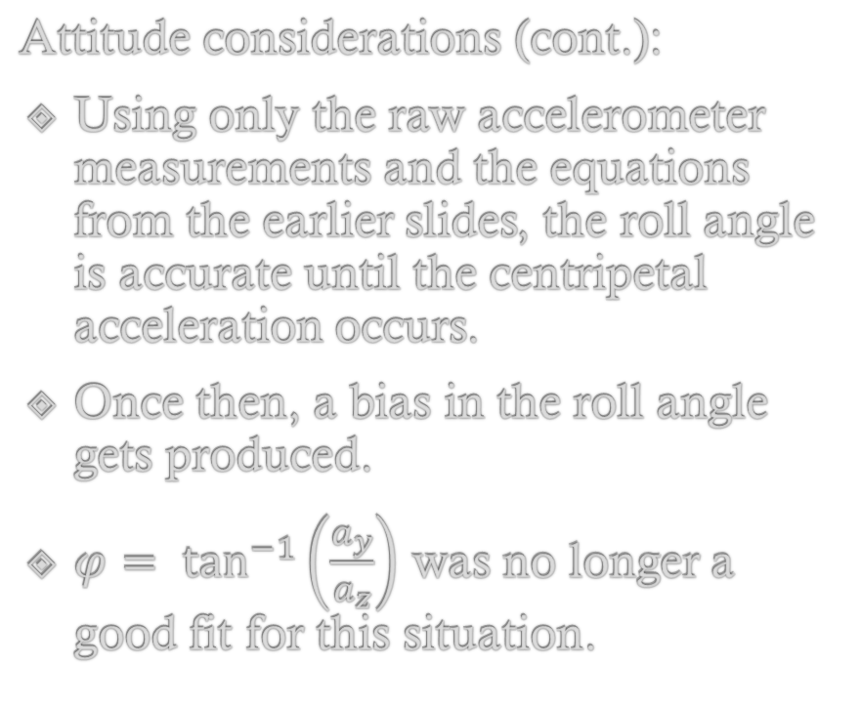
Analysis
Attitude considerations (cont.):
Using only the raw accelerometer measurements and the equations from the earlier slides, the roll angle is accurate until the centripetal acceleration occurs.
Once then, a bias in the roll angle gets produced.
$φ= \tan^{−1}\left(\frac{a_{y}}{a_{z}}\right)$ was no longer a good fit for this situation.

Slide 35
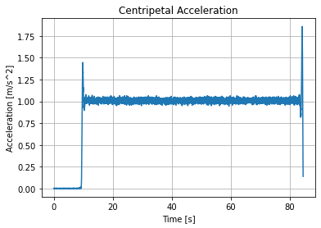
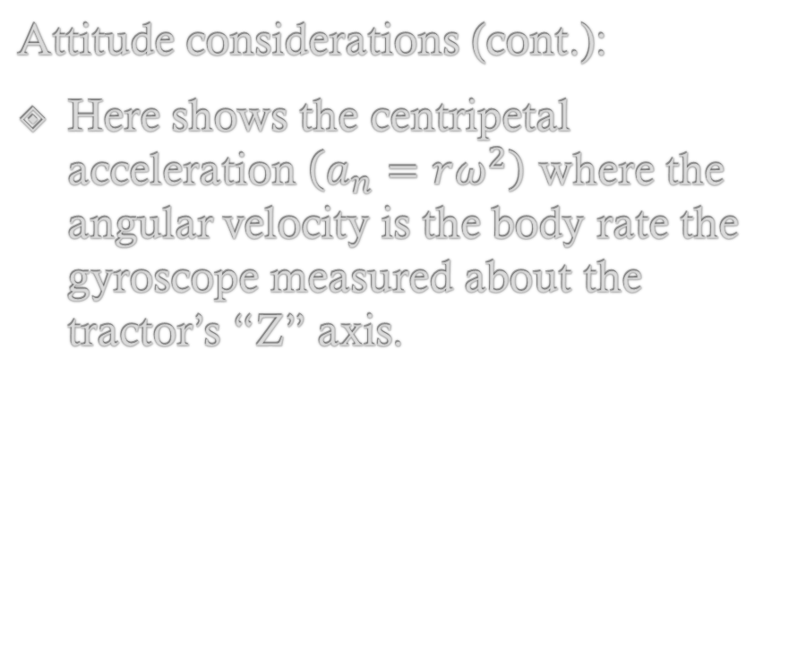
Analysis
Attitude considerations (cont.):
Here shows the centripetal acceleration $\left(a_{n}=rω^{2}\right)$ where the angular velocity is the body rate the gyroscope measured about the tractor’s “Z” axis.

Slide 36
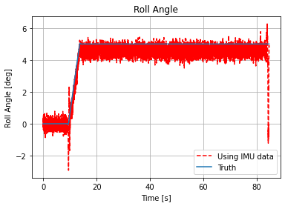
Analysis
Attitude considerations (cont.):
After accounting for this added acceleration, the roll angle was closer to the truth (albeit still noisy due to the nature of accelerometers)

Slide 37
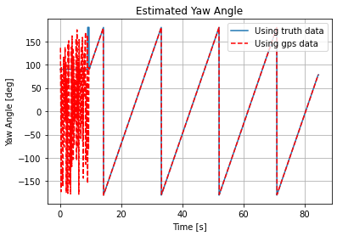
Analysis
Attitude considerations (cont.):
After a brief transient period, the heading estimates match the truth data very well.
The transient period is perhaps due to the nature of the UKF. There have been issues in the past where estimates are not “latching on” right away.
It could also be due to the GPS measurements at the early part of the run.

Slide 38
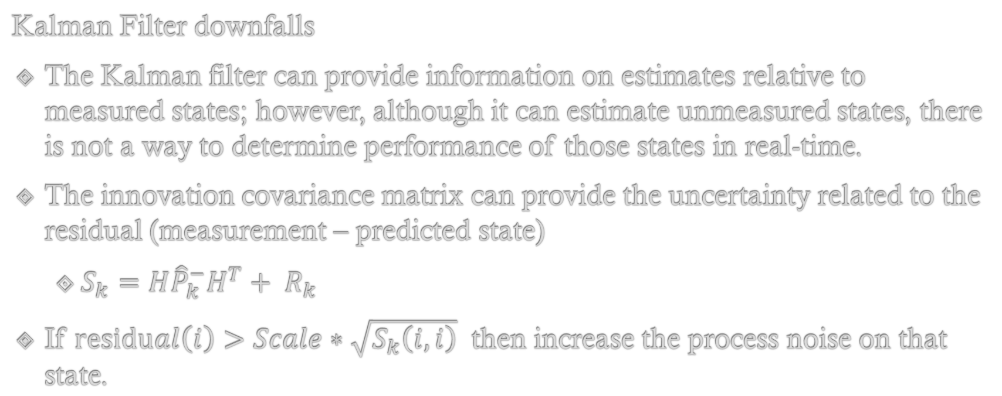
Limitations and improvements
Kalman Filter downfalls
The Kalman filter can provide information on estimates relative to measured states; however, although it can estimate unmeasured states, there is not a way to determine performance of those states in real-time.
The innovation covariance matrix can provide the uncertainty related to the residual (measurement – predicted state)
$S_{k}=H{\hat{P}}_{k}^{−}H^{T}+ R_{k}$
If $residual\left(i\right)>Scale∗\sqrt{S_{k}\left(i,i\right)}$ then increase the process noise on that state.

Slide 39
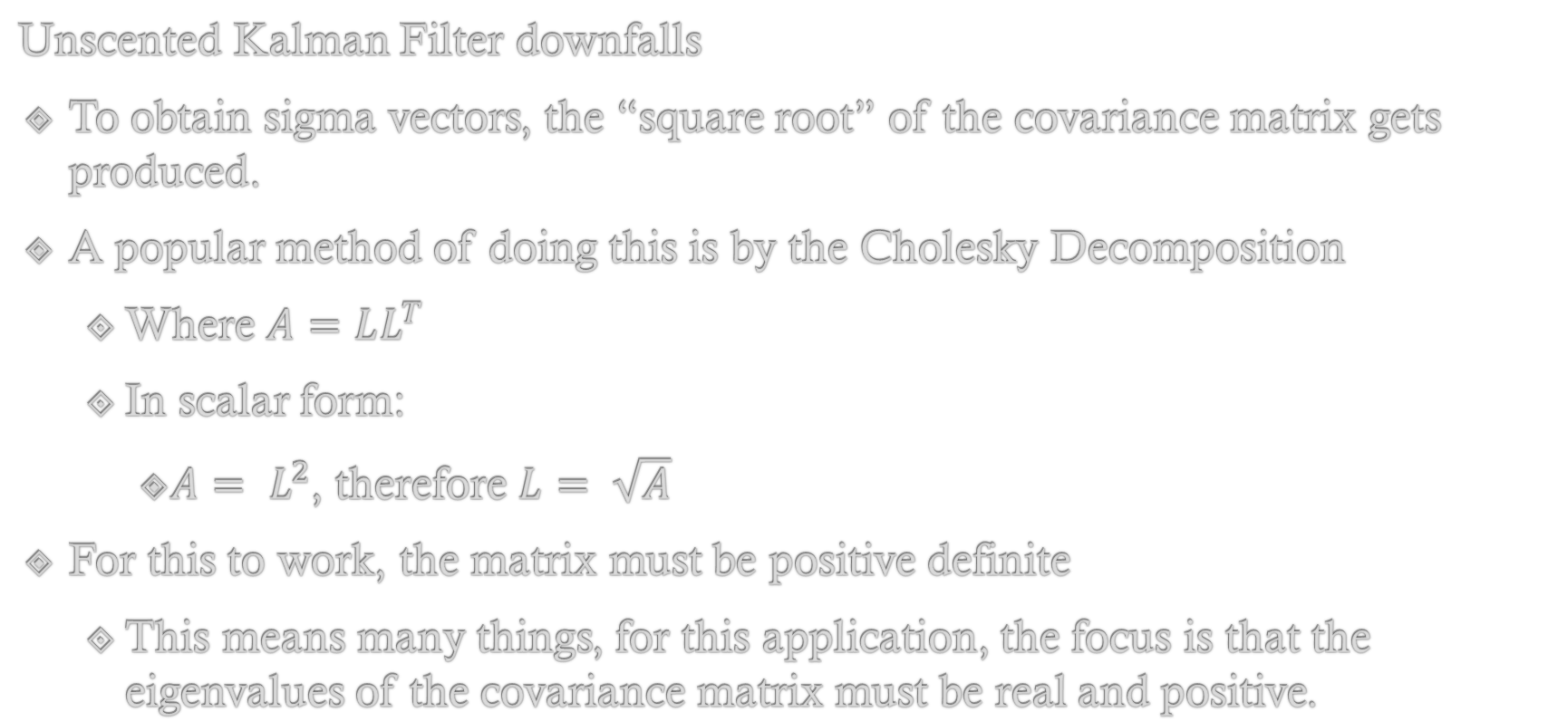
Limitations and improvements
Unscented Kalman Filter downfalls
To obtain sigma vectors, the “square root” of the covariance matrix gets produced.
A popular method of doing this is by the Cholesky Decomposition
Where $A=LL^{T }$
In scalar form:
$A= L^{2}$, therefore $L= \sqrt{A}$
For this to work, the matrix must be positive definite
This means many things, for this application, the focus is that the eigenvalues of the covariance matrix must be real and positive.

Slide 40
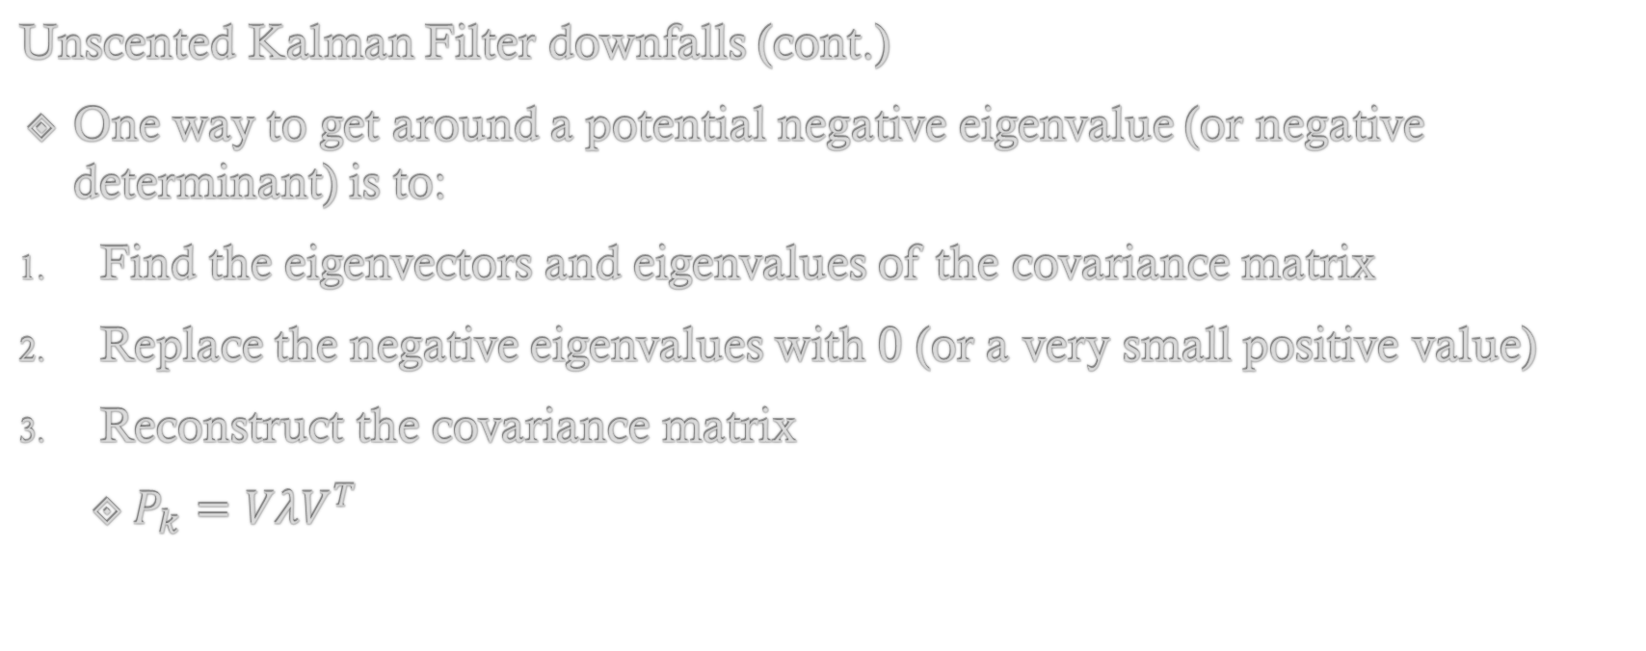
Limitations and improvements
Unscented Kalman Filter downfalls (cont.)
One way to get around a potential negative eigenvalue (or negative determinant) is to:
Find the eigenvectors and eigenvalues of the covariance matrix
Replace the negative eigenvalues with 0 (or a very small positive value)
Reconstruct the covariance matrix
$P_{k}=VλV^{T}$

Slide 41
Limitations and improvements
Unscented Kalman Filter downfalls (cont.)
One method of utilizing the algorithm involves generating 2n+1 sigma vectors. The mean value (using the previous estimate or the initial value) as well as an even number of vectors around the mean.
The more states in the algorithm, the more sigma vectors (sigma points).
This potentially can dramatically slow down the algorithm.
Depending on hardware limitations, the UKF might be better for simulation purposes and the EKF (or another variation) could be utilized for real-time applications.

Slide 42
Limitations and improvements
Time constraints
If given unlimited time, a multiple solution approach could have been examined.
A few examples include:
EKF vs UKF comparison
Total state vs Error State implementation
Selection of different states (perhaps different frame or different quantities such as latitude and longitude)
Accounting for more sources of error in the algorithm
A ‘spike’ detection method to check for jumps in measurements.
A more robust integration technique such as a 4th order Runge-Kutta

Slide 43
Back up

Slide 44
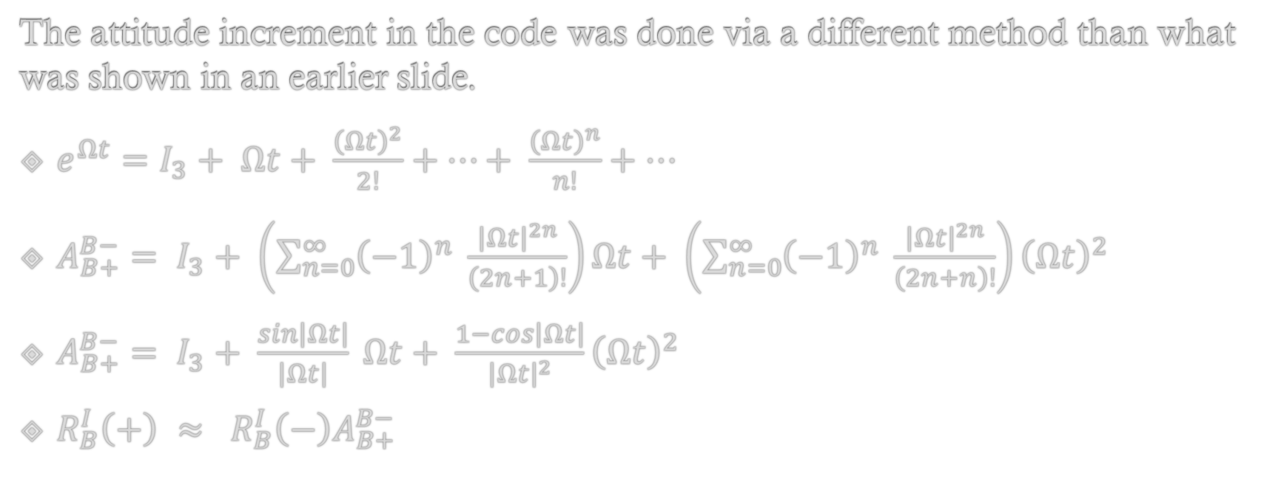
BACK UP
The attitude increment in the code was done via a different method than what was shown in an earlier slide.
$e^{Ωt}=I_{3}+ Ωt+ \frac{{\left(Ωt\right)}^{2}}{2!}+…+ \frac{{\left(Ωt\right)}^{n}}{n!}+…$
$A_{B+}^{B−}= I_{3}+ \left(\sum_{n=0}^{∞}{{\left(−1\right)}^{n} \frac{{\left|Ωt\right|}^{2n}}{\left(2n+1\right)!}}\right)Ωt+ \left(\sum_{n=0}^{∞}{{\left(−1\right)}^{n} \frac{{\left|Ωt\right|}^{2n}}{\left(2n+n\right)!}}\right){\left(Ωt\right)}^{2}$
$A_{B+}^{B−}= I_{3}+ \frac{sin\left|Ωt\right|}{\left|Ωt\right|} Ωt+ \frac{1−cos\left|Ωt\right|}{{\left|Ωt\right|}^{2}}{\left(Ωt\right)}^{2}$
$R_{B}^{I}\left(+\right) ≈ R_{B}^{I}\left(−\right)A_{B+}^{B−}$

Slide 45
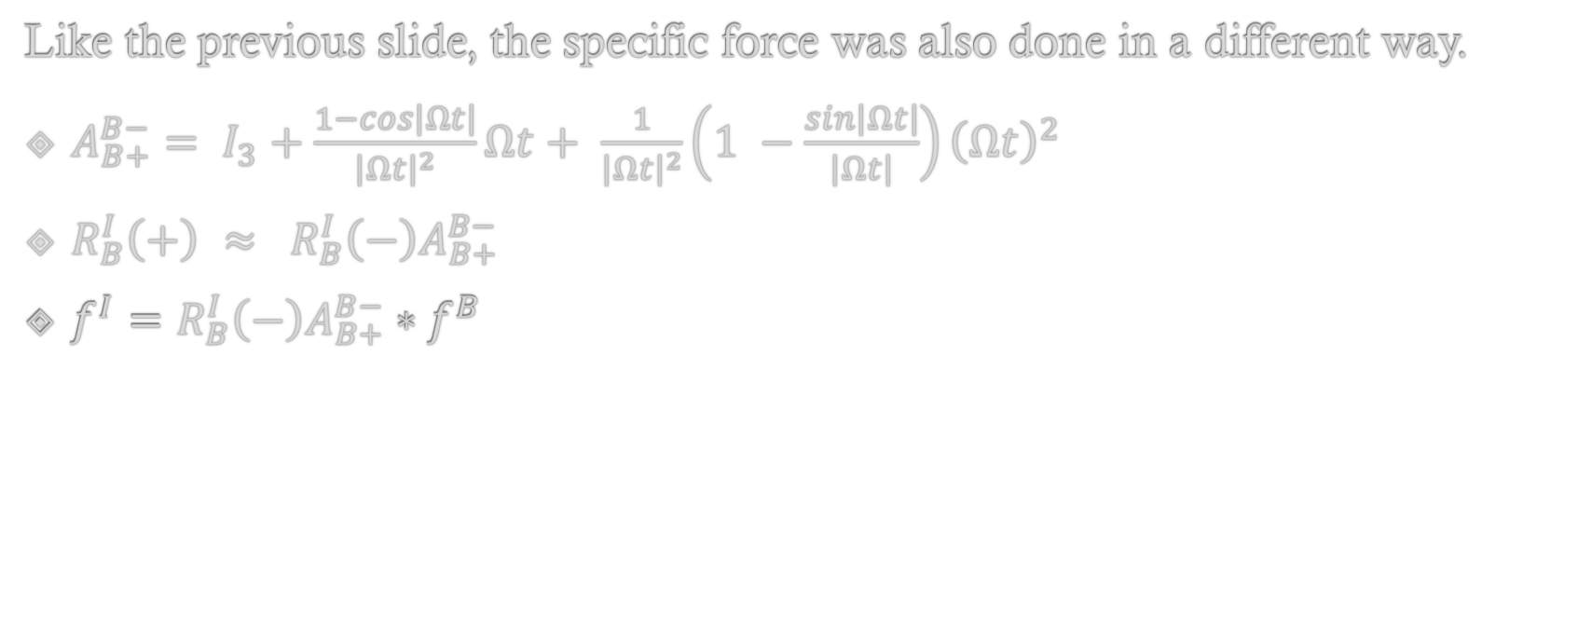
BACK UP
Like the previous slide, the specific force was also done in a different way.
$A_{B+}^{B−}= I_{3}+\frac{1−cos\left|Ωt\right|}{{\left|Ωt\right|}^{2}}Ωt+ \frac{1}{{\left|Ωt\right|}^{2}}\left(1 −\frac{sin\left|Ωt\right|}{\left|Ωt\right|}\right){\left(Ωt\right)}^{2}$
$R_{B}^{I}\left(+\right) ≈ R_{B}^{I}\left(−\right)A_{B+}^{B−}$
$f^{I}=R_{B}^{I}\left(−\right)A_{B+}^{B−}∗{ f}^{B}$

Slide 46
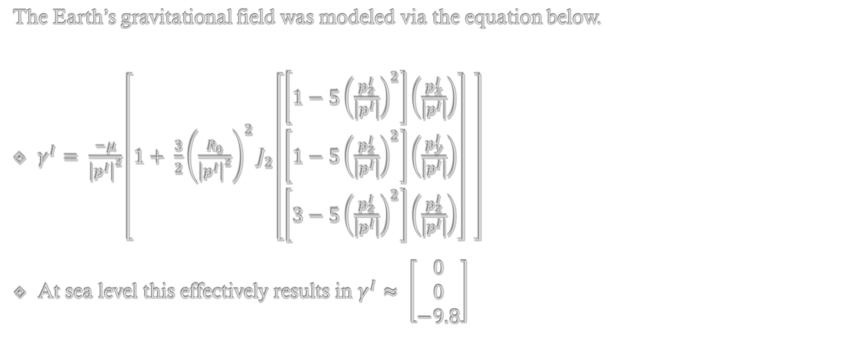
BACK UP
The Earth’s gravitational field was modeled via the equation below.
$γ^{I}= \frac{−μ}{{\left|p^{I}\right|}^{2}}\left[1+ \frac{3}{2}{\left(\frac{R_{0}}{{\left|p^{I}\right|}^{2}}\right)}^{2}J_{2}\left[\begin{matrix}\left[1−5{\left(\frac{p_{z}^{I}}{\left|p^{I}\right|}\right)}^{2}\right]\left(\frac{p_{x}^{I}}{\left|p^{I}\right|}\right) \\ \left[1−5{\left(\frac{p_{z}^{I}}{\left|p^{I}\right|}\right)}^{2}\right]\left(\frac{p_{y}^{I}}{\left|p^{I}\right|}\right) \\ \left[3−5{\left(\frac{p_{z}^{I}}{\left|p^{I}\right|}\right)}^{2}\right]\left(\frac{p_{z}^{I}}{\left|p^{I}\right|}\right)\end{matrix}\right] \right]$
At sea level this effectively results in $γ^{I}≈ \left[\begin{matrix}0 \\ 0 \\ −9.8\end{matrix}\right]$

Slide 47
References
Paul D. Groves (2008). Principles of GNSS, Inertial, and Multisensor Integrated
Navigation Systems. GNSS Technology and Application.
Stevens, B.L., Lewis, F.L., & Johnson, E.N. (2016). Aircraft control and simulation: dynamics, controls design, and autonomous systems. John Wiley & Sons.
Zarchan, P., & Musoff, H. (2015). Progress in astronautics and aeronautics. Volume 246, Fundamentals of Kalman filtering: a practical approach. American Institute of Aeronautics And Astronautics.

